Slide 1

Trigonometric
Functions

Slide 2
CONTENTS
TRIGONOMETRISTS
HISTORY
CONVERSION OF ANGLES
TRIGONOMETRIC RATIOS
GRAPHS
TRIGONOMETRIC IDENTITIES

Slide 3
CONTINUED…
A-D FORMULAE
C-D FORMULAE
2θ, 3θ FORMULAE
LAW OF SINES
LAW OF COSINES
GENERAL SOLUTIONS

Slide 4
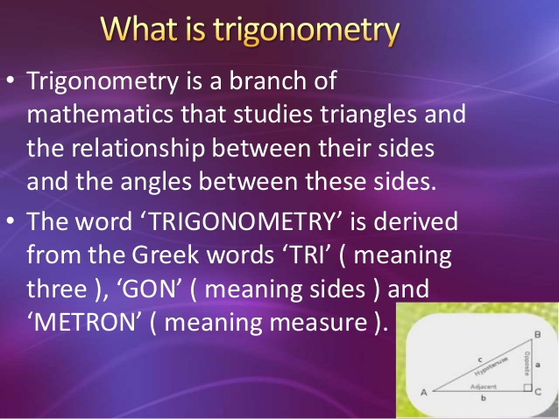

Slide 5
Conversion of Angles
Angles can be measured in- Degree, Radian, Minute or Second.
Degree to Radian: Radian(r)- Degree*(π/180)
Radian to Degree: Degree(d)- Radian*(180/π)
Minute to Degree: Degree(d)- 1/60*minute
Second to Degree: Degree(d)- 1/3600*second

Slide 6
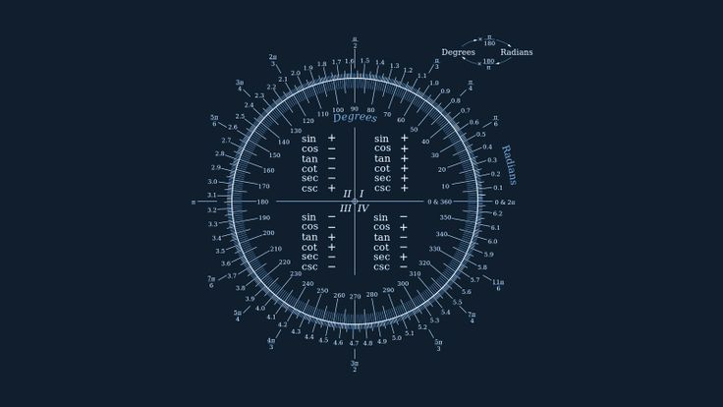

Slide 7
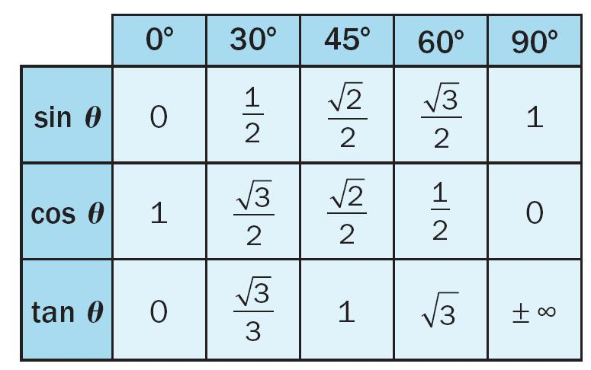
Trigonometric Ratios

Slide 8
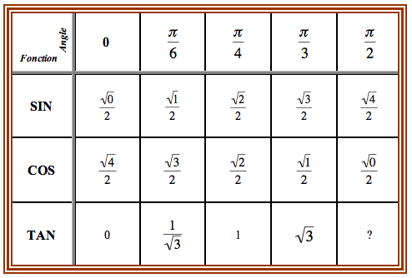

Slide 9
Trigonometric Ratios
COMPLEMENTARY ANGLES
Sin(90-θ)= c0s θ
c0s(90-θ)= sin θ
tan(90-θ)= cot θ
SUPPLEMENTARY ANGLES
Sin(90+θ)= c0s θ
Cos(90+θ)= -sin θ
Tan(90+θ)= -cot θ

Slide 10
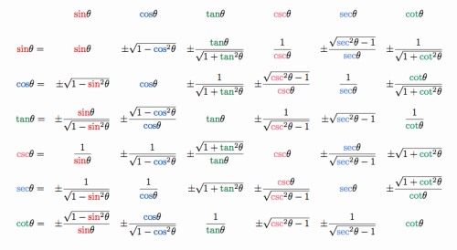

Slide 11
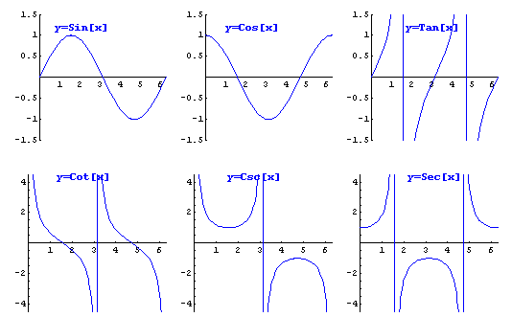
Graphs

Slide 12

Trigonometric Identities
Pythagorean Identities
sin² θ + cos² θ = 1
tan² θ + 1 = sec² θ
cot² θ + 1 = csc² θ
0dd/ Even Identities
sin (–x) = –sin x
c0s (–x) = c0s x
tan (–x) = –tan x

Slide 13

A-B Formula
Sin(A+B) = sin A c0s B + c0s A sin B
Sin(A-B) = sin A c0s B + c0s A sin B
C0s(A+B) = c0s A c0s B – sin A sin B
C0s(A-B) = c0s A c0s B + sin A sin B
Tan(A+B) = [tan A + tan B]/ [1- tan A tan B]
Tan(A-B) = [tan A – tan B]/ [1+ tan A tan B]
Cot(A+B) = [cot A cot B - 1]/ [cot B + cot A]
Cot(A-B) = [cot A cot B + 1]/ [cot B – cot A]

Slide 14

C-D Formula
sin C + sin D = 2 sin (C+D)/2 c0s (C-D)/2
Sin C - sin D = 2 c0s(C+D)/2 sin (C-D)/2
Cos C + c0s D = 2 c0s(C+D)/2 c0s (C-D)/2
Cos C - c0s D = -2 sin(C+D)/2 sin(C-D)/2

Slide 15
2θ, 3θ Formula
Sin 2θ = 2 sin θ c0s θ , [2 tan θ]/ 1+ tan² θ
Sin 3θ = 3 sin θ – 4 sin³ θ
C0s 2θ = cos² θ - sin² θ = 2 cos² θ -1 = 1- 2 sin² θ
= 1- tan² θ /1+ tan² θ
Cos 3θ = 4 c0s³ θ – 3 c0s θ
Tan 2θ = 2 tanθ/1- tan² θ
Tan 3θ = 3 tanθ - tan³ θ/1- 3 tan² θ

Slide 16
Other Formulae
Cos(A+B) +c0s(A-B) = 2c0s A c0s B
Cos(A+B) -c0s(A-B) = -2sin A sin B
Sin(A+B) +sin(A-B) = 2sin A c0s B
Sin(A+B) –sin(A-B) = 2c0s A sin B

Slide 17
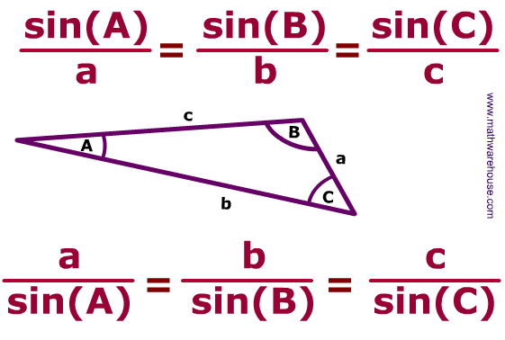

Slide 18

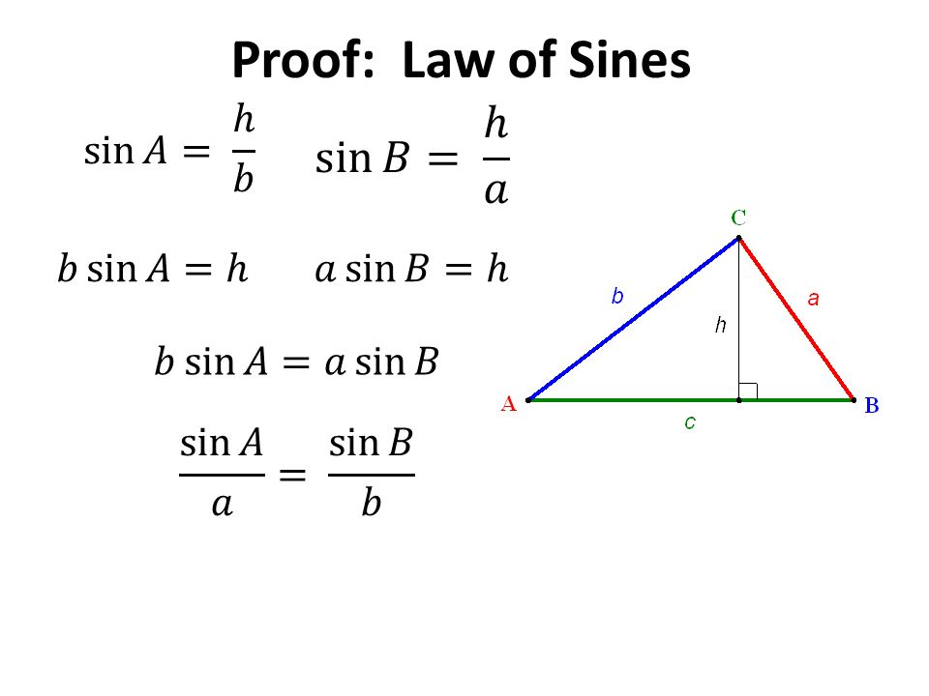
Sine Rule

Slide 19
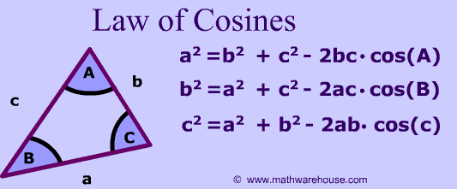

Slide 20
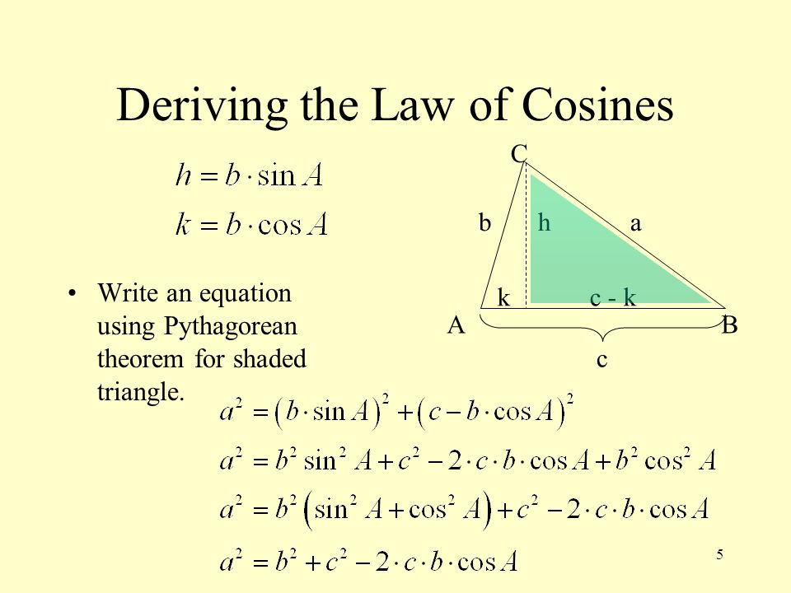

Slide 21

General Solutions
General solution of sin θ = 0 , θ = n π, n € Z
General solution of sin θ = sinα, θ = nπ+(-1)^nα, n € Z
General solution of c0s θ = 0 , θ = (2n+1) π/2, n € Z
General solution of c0s θ = c0sα, θ = 2n π±α, n € Z
General solution of tan θ = 0 , θ = n π, n € Z
General solution of tan θ = tanα, θ = n π+ α, n € Z

Slide 22
Applications of trigonometry
ASTRONOMICAL and ARCHITECTURAL etc.

Slide 23
* The technique of triangulation is used in astronomy to measure the distance to nearby stars, in Geography to measure distances between landmarks, and in satellite navigation systems.
* The sine and cosine functions are fundamental to the theory of periodic functions, such as those that describe sound and light waves.

Slide 24
Fields that use trigonometry or trigonometric functions include astronomy (especially for locating apparent positions of celestial objects, in which spherical trigonometry is essential) and hence navigation (on the oceans, in aircraft, and in space), music theory, audio synthesis, acoustics, optics, electronics, biology, medical imaging (CAT scans and ultrasound), pharmacy, chemistry, number theory (and hence cryptology), seismology, meteorology, oceanography, many physical sciences, land surveying and geodesy, architecture, image compression, phonetics, economics, electrical engineering, mechanical engineering, civil engineering, computer graphics, cartography, crystallography and game development.

Slide 25



